Slide 1
Telling a Story by Visualizing MIMIC-III Data
Jaykumar Patel

Slide 2
Introduction
The MIMIC-III dataset provides a comprehensive view of hospital patient records.
I introduce new visualizations regarding abnormality of tests and patient analysis.
These visualizations provide a deeper understanding of trends that can aid in healthcare analysis.
Note: All plots are from the Matplotlib, Seaborn, and Plotly library.

Slide 3
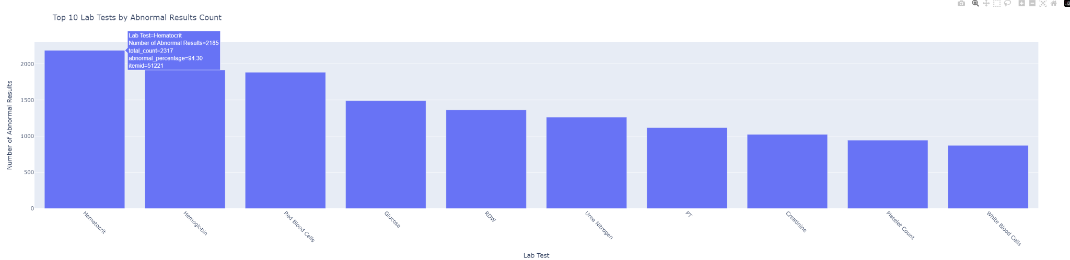
Abnormal Tests
The bar chart below shows the lab tests with the highest number of abnormal values.
Hovering on the bars shows the test name, number of occurrences, total number of abnormal values, and the percentage of abnormal occurrences.
Data shows that “Hematocrit”, “Hemoglobin”, and “Red Blood Cells” have the highest number of abnormal values.
I will focus on those tests for my deeper analysis.

Slide 4
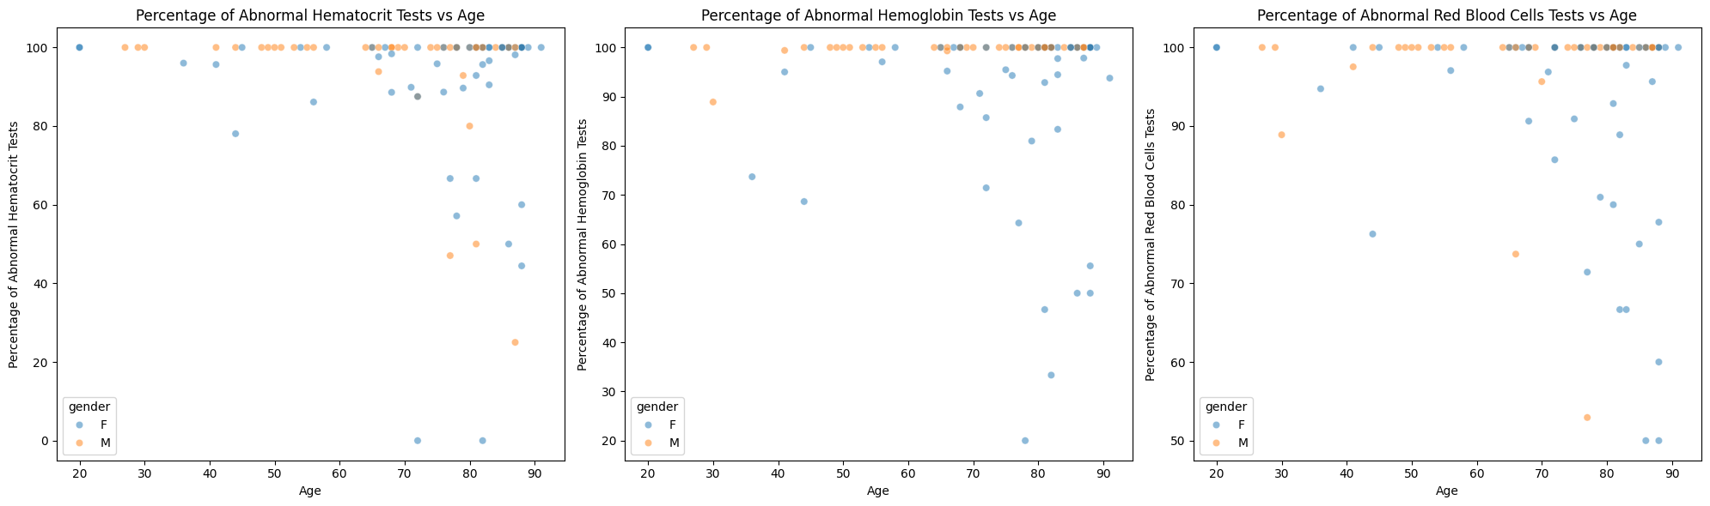
Percentage of Abnormal Tests vs Age
The scatter plots below show the percentage of abnormal tests versus age (split by gender), for each of the 3 tests mentioned in the previous slide.
An interesting insight is that for ages above 60, more Females tend to have lower percentages of abnormal tests than Males.
This is shown by the higher variance in the distribution of the blue dots (Females) compared to the orange dots (Males).

Slide 5
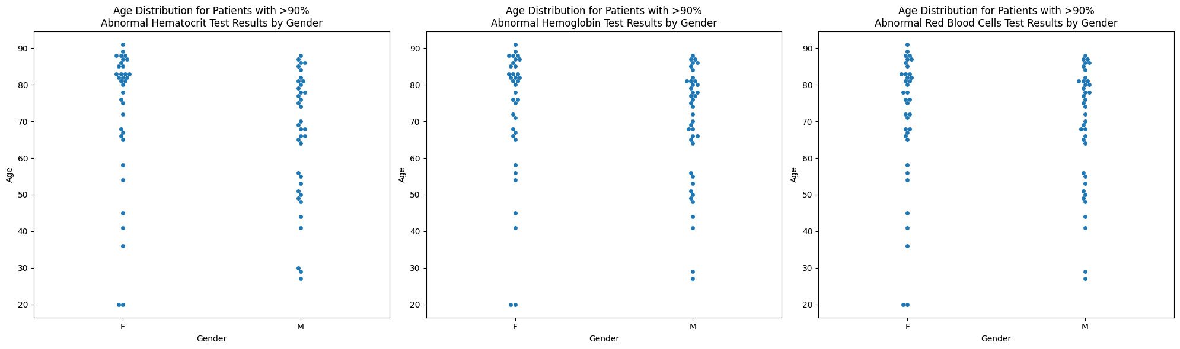
Age Distribution of Patients with >90% Abnormal Tests
For each of the 3 tests, the swarm plots below show the age distribution of patients with greater than 90% abnormal test results (split by gender).
It is evident that more Males under 60 have at least 90% abnormal test results compared to Females, for all tests.

Slide 6
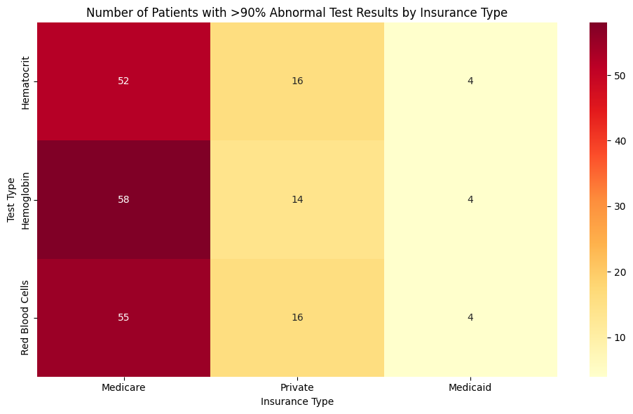
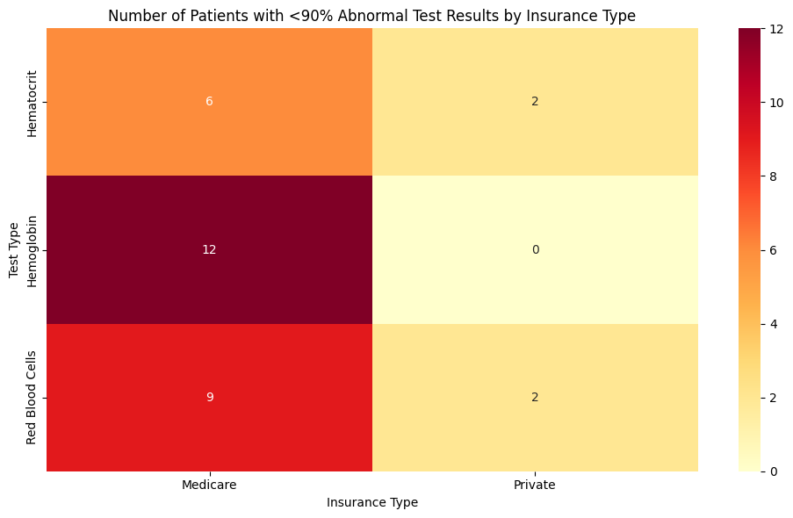
Comparison of Insurance
The heatmaps show the number of patients who had >90% abnormal results (top) and <90% abnormal results (bottom) for 3 tests split by insurance.
A significantly higher number of patients (those with greater and less than 90% of abnormal tests) have Medicare than Private or Medicaid.
It is important to note that a patient can have abnormal results for multiple tests, but cannot have multiple types of insurance.
A patient can belong to multiple rows, within the same column, but not multiple columns within the same row.

Slide 7
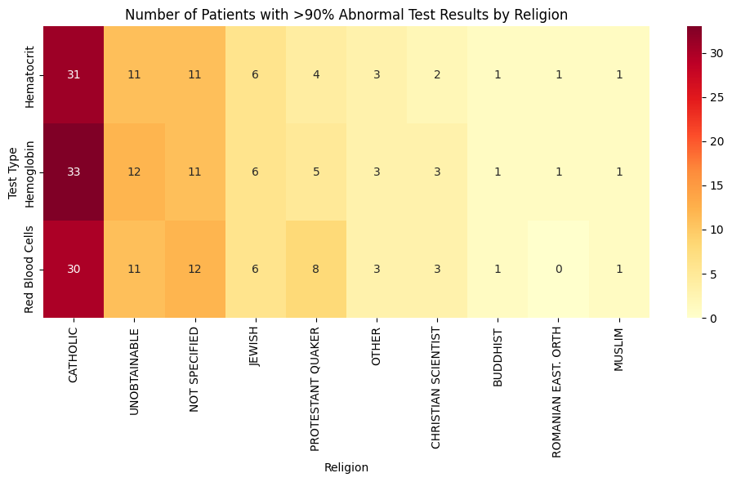
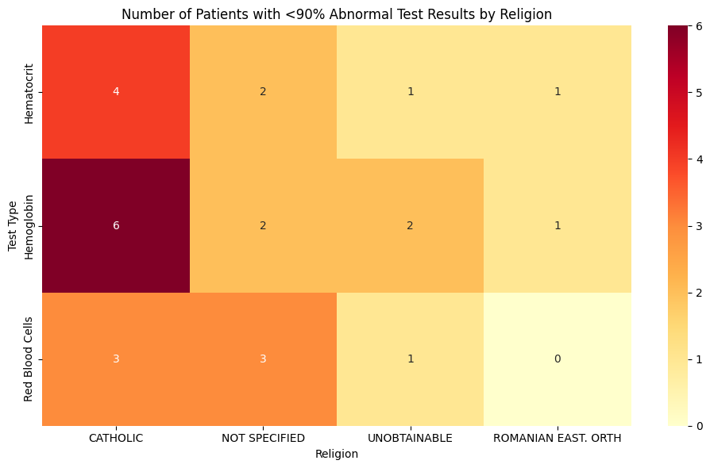
Comparison of Religion
The heatmaps show the number of patients who had >90% abnormal results (top) and <90% abnormal results (bottom) for 3 tests split by religion.
Catholic patients have the highest number of individuals with >90% abnormal test results across all tests.
However, catholic patients have the highest number of individuals with <90% abnormal test results for only Hematocrit and Hemoglobin tests.
It is important to note that a patient can have abnormal results for multiple tests, but cannot have multiple types of religion.
A patient can belong to multiple rows, within the same column, but not multiple columns within the same row.

Slide 8
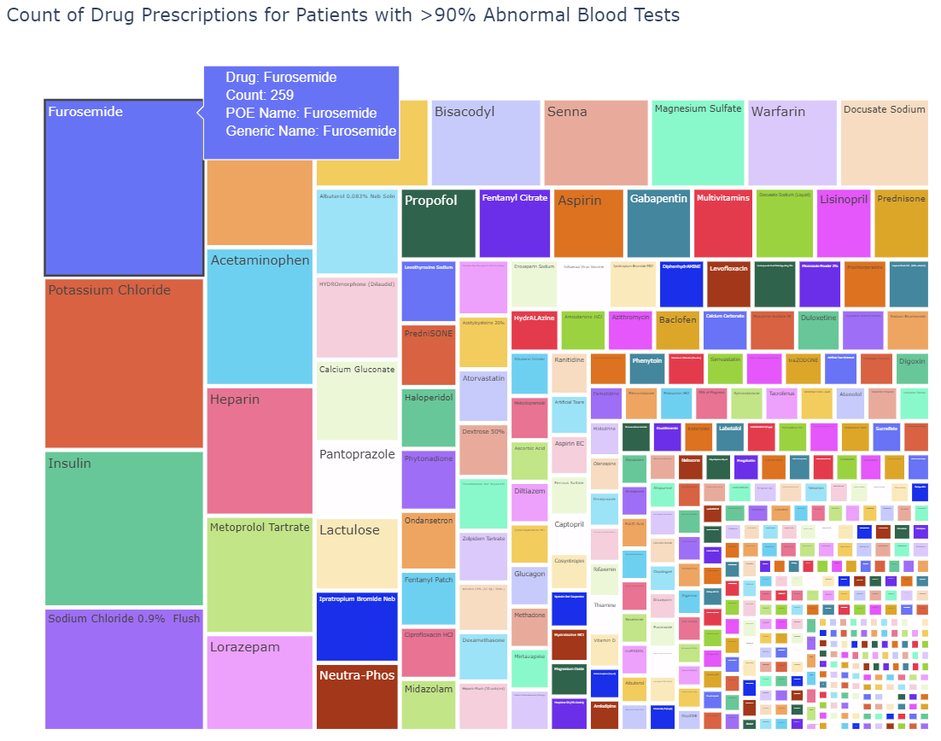
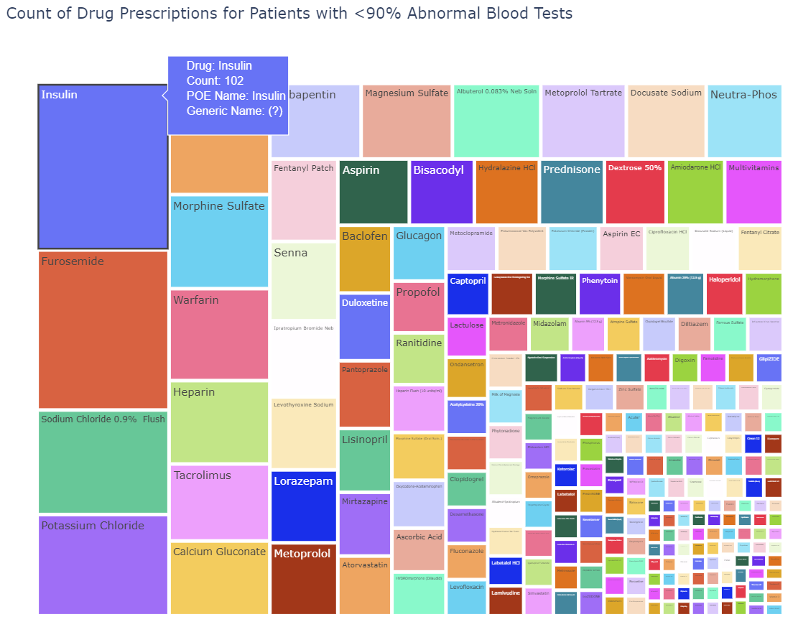
Comparison of Prescriptions
The treeplots show the prescription counts for patients with >90% abnormal results (top) and <90% abnormal results (bottom.
For patients with >90% abnormal results for the 3 tests, the most prescribed drug is Furosemide.
For patients with <90% abnormal results for the 3 tests, the most prescribed drug is Insulin.

Slide 9
Conclusion
The plots analyze abnormal tests data.
Additionally, they analyze insurance, religion, and prescription data for patients with greater than and patients with less than 90% abnormal test results.
The visualizations demonstrate the complex and interconnected nature of the MIIMIC-III dataset.
Using various Python libraries (Matplotlib, Seaborn, and Plotly), we can extract insightful information that can be used by healthcare professionals to
Identify trends
Improve decision-making
Develop predictive models

Slide 10
Data and Libraries Used
Here are the `.csv` files that were used for visualization
Patients Data - PATIENTS.csv
Admissions Data - ADMISSIONS.csv
Prescription Data - PRESCRIPTIONS.csv
Lab Data - LABEVENTS.csv, D_LABITEMS.csv
Here are the libraries that were used for visualization
Matplotlib
Seaborn
Plotly

